Slide 1


Andrey Koleda
10 Nov 2021

Slide 2

Outline
Executive Summary
Introduction
Methodology
Results
Conclusion
Appendix

Slide 3
Executive Summary
Summary of methodologies
Data collection
Data wrangling
EDA with visualization
EDA with SQL
Building an interactive map with Folium
Building a Dashboard with Plotly Dash
Predictive analysis
Summary of all results
Exploratory data analysis results
Interactive analytics demo in screenshot
Predictive analysis results

Slide 4
Introduction
Project background and context
Problems that needed solving
We will predict if the Falcon 9 first stage will land successfully. SpaceX advertises Falcon 9 rocket launches on its website, with a cost of 62 million dollars; other providers cost upward of 165 million dollars each, much of the savings is because SpaceX can reuse the first stage.
What factors influence the successful landing?
What parameters should be used for optimal landing?
What is the probability?

Slide 5


Slide 6
Methodology
Executive Summary
Data collection methodology:
RestAPI and Web Scrapping
Perform data wrangling
Filling in the missing values and deleting unnecessary columns and
One Hot Encoding (OHE)
Perform exploratory data analysis (EDA) using visualization and SQL
Perform interactive visual analytics using Folium and Plotly Dash
Perform predictive analysis using classification models
How to build, tune, evaluate classification models

Slide 7
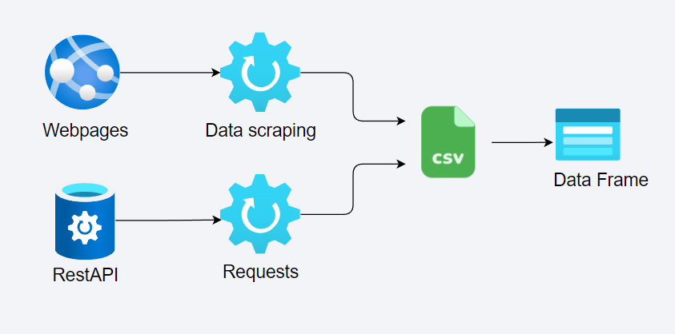
Data Collection
How data sets were collected.
We use the SpaceX API to collect data about rockets and their launches and landings. But there is not enough data. To enrich the dataset, we use data parsing from Wikipedia.

Slide 8
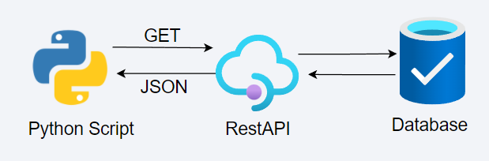
Data Collection – SpaceX API
Using Python, we access the SpaceX API and get data in JSON format and combine everything into one dataset
Base URL: https://api.spacexdata.com/v4/{endpoint}
Endpoints: rockets, launchpad, payloads, cores, etc.
https://github.com/koav/IBM-DataScience-SpaceX-Project/blob/master/w01-01-data-collection-api.ipynb
Notes:
https://github.com/koav/IBM-DataScience-SpaceX-Project/blob/master/w01-01-data-collection-api.ipynb

Slide 9
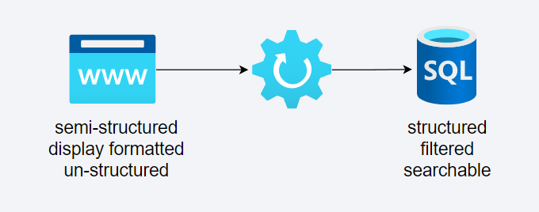
Data Collection - Scraping
Sending an HTTP GET request to the URL of the webpage that we want to scrape which will respond with HTML content (Wikipedia)
Fetching and parsing the data using Beautifulsoup
https://github.com/koav/IBM-DataScience-SpaceX-Project/blob/master/w01-01-data-collection-api.ipynb

Slide 10
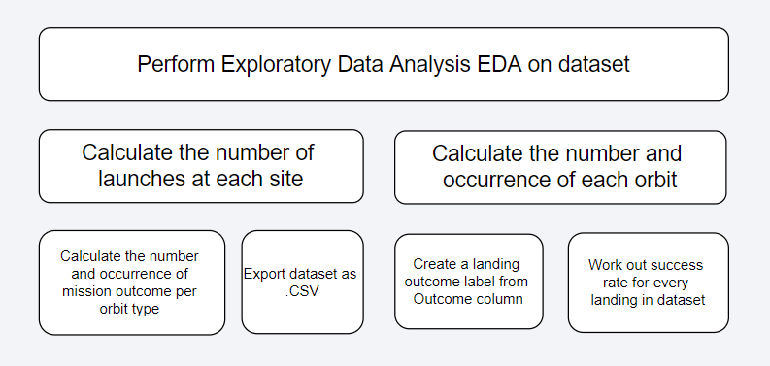
Data Wrangling
In the dataset there is when the rocket landed not successfully. There are launches in our dataset on land (RTLS) or at sea (ASDS / Ocean).
We mainly convert those outcomes into Training Labels with 1 means the booster successfully landed 0 means it was unsuccessful
https://github.com/koav/IBM-DataScience-SpaceX-Project/blob/master/w01-03-data-wrangling.ipynb

Slide 11
EDA with Data Visualization
Scatter Graphs being drawn:
Flight Number VS. Payload Mass
Flight Number VS. Launch Site
Payload VS. Launch Site
Orbit VS. Flight Number
Payload VS. Orbit Type
Bar Graph being drawn
Mean VS. Orbit
Line Graph being drawn
Success Rate VS. Year
https://github.com/koav/IBM-DataScience-SpaceX-Project/blob/master/w02-02-eda-dataviz.ipynb

Slide 12
EDA with SQL
Performed SQL queries to gather information about the dataset
Displaying the names of the unique launch, 'KSC’ launches, total payload mass carried by boosters launched by NASA (CRS)
Displaying average payload mass carried by booster
Listing the date where the successful landing outcome in drone ship was achieved.
Listing the names of the boosters which have success in ground
Listing the total number of successful and failure mission outcomes
Listing the names of the booster_versions which have carried the maximum payload mass.
Listing the records which will display the month names, successful landing_outcomes in ground pad ,booster versions
https://github.com/koav/IBM-DataScience-SpaceX-Project/blob/master/w02-01-eda-sql.ipynb

Slide 13
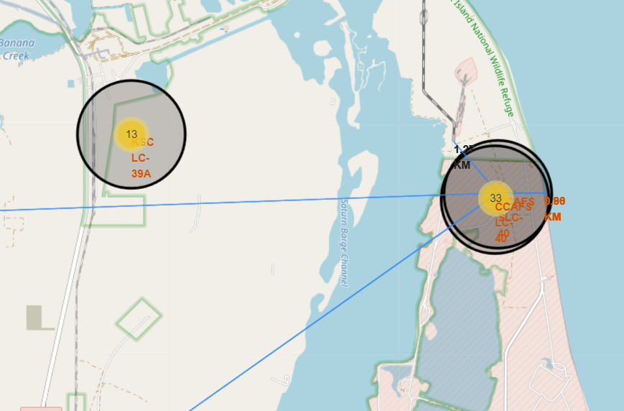
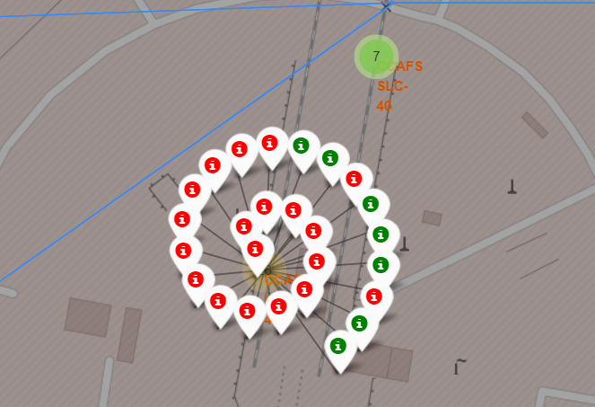
Build an Interactive Map with Folium
Using Haversine’s formula we calculated the distance from the Launch Site to various landmarks to find various trends about what is around the Launch Site to measure patterns
https://github.com/koav/IBM-DataScience-SpaceX-Project/blob/master/w03-01-launch_site_location.ipynb

Slide 14
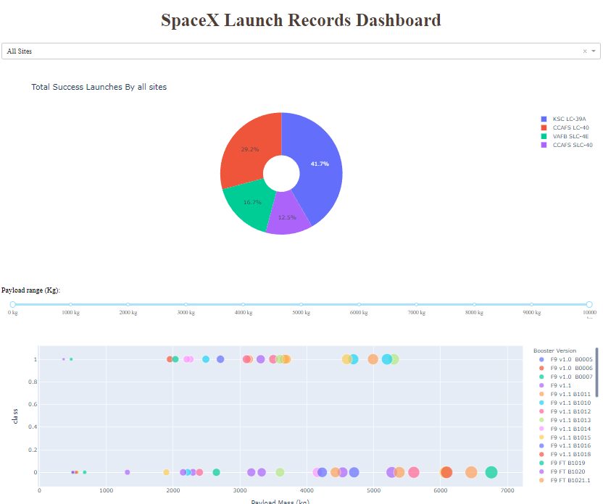
Build a Dashboard with Plotly Dash
Created an interactive dashboard with metrics using Dash
Pie Chart showing the total launches by a certain site/all sites
Scatter Graph showing the relationship with Outcome and Payload Mass (Kg) for the different Booster Versions
https://github.com/koav/IBM-DataScience-SpaceX-Project/blob/master/scripts/spacex_dash_app.py

Slide 15
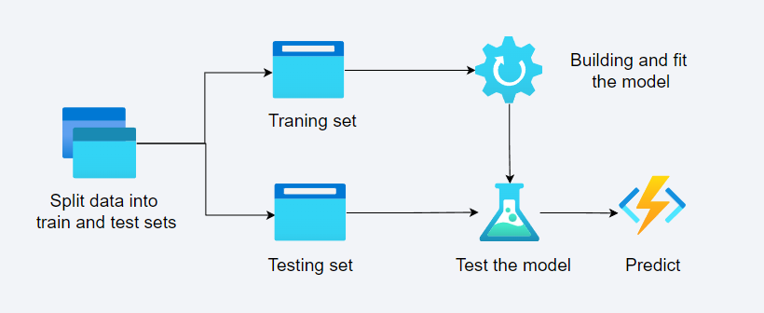
Predictive Analysis (Classification)
How did we get a quality model
Load our dataset
Transform data
Split our data into training and test data sets
Use learning algorithms and parameters
Fit and find best parameters with GridSearchCV
Check the score for each mode
Improve the model
https://github.com/koav/IBM-DataScience-SpaceX-Project/blob/master/w04-01-predictions.ipynb

Slide 16


Results
Exploratory data analysis results
Interactive analytics demo in screenshots
Predictive analysis results

Slide 17


Slide 18
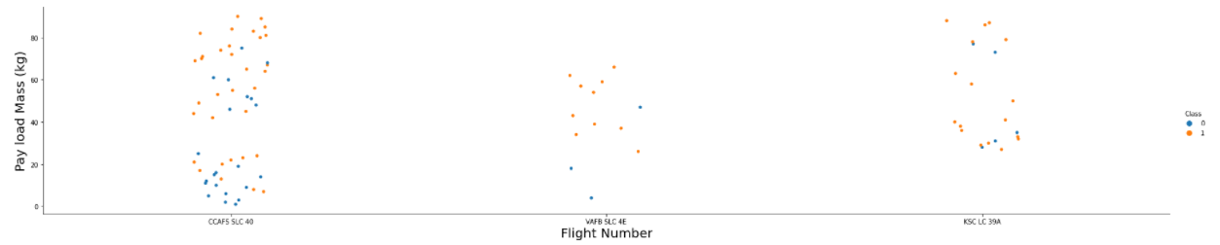
Flight Number vs. Launch Site
The more amount of flights at a launch site the greater the success rate at a launch site

Slide 19
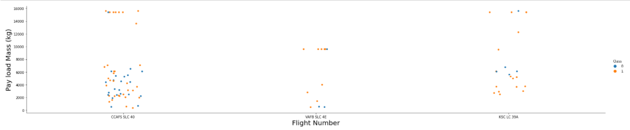
Payload vs. Launch Site
The greater the payload mass for Launch Site CCAFS SLC 40 the higher the success rate for the Rocket

Slide 20
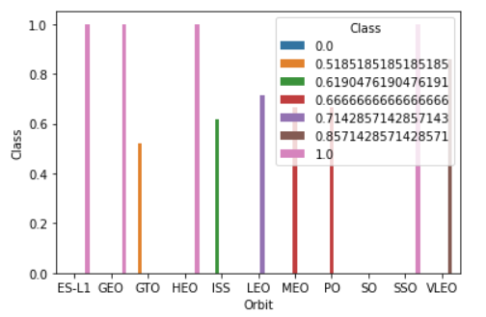
Success Rate vs. Orbit Type
Orbits ES-L1, GEO, HEO, SSO has the best Success Rate

Slide 21
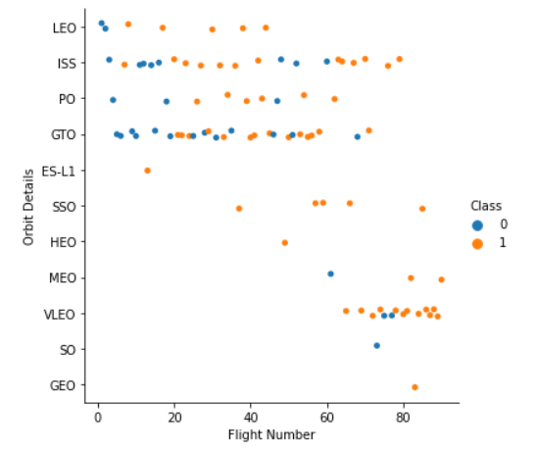
Flight Number vs. Orbit Type
You should see that in the LEO orbit the Success appears related to the number of flights; on the other hand, there seems to be no relationship between flight number when in GTO orbit.

Slide 22
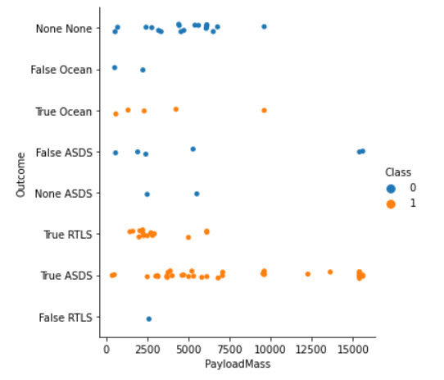
Payload vs. Orbit Type
With heavy payloads the successful landing or positive landing rate are more for Polar, LEO and ISS

Slide 23
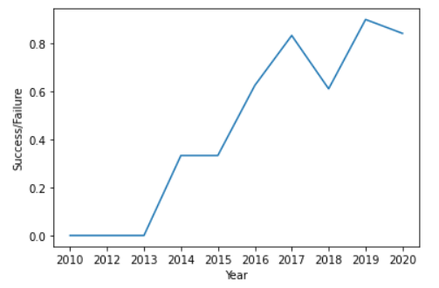
Launch Success Yearly Trend
Here you can observe that the success rate since 2013 kept increasing till 2020

Slide 24
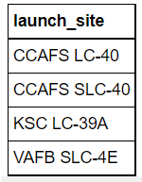
All Launch Site Names
The names of the unique launch sites in the space mission

Slide 25
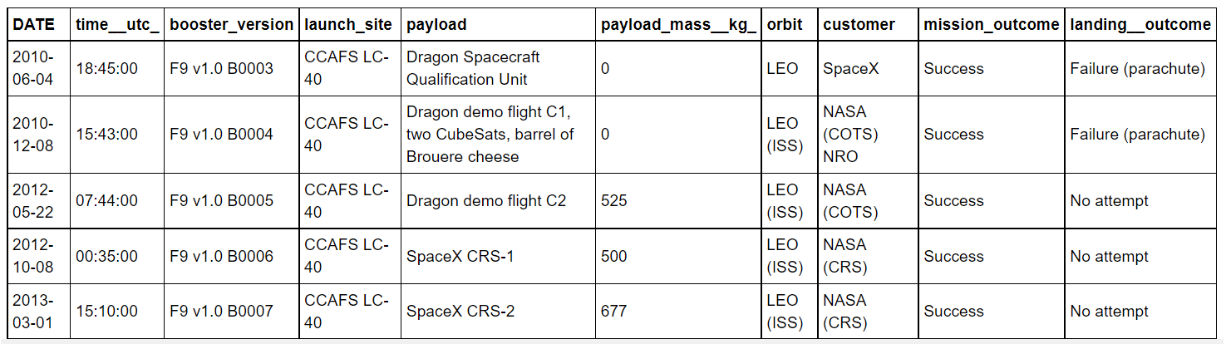
Launch Site Names Begin with 'CCA'
5 records where launch sites begin with `CCA`

Slide 26
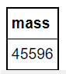
Total Payload Mass
Total payload mass carried by boosters launched by NASA (CRS)

Slide 27
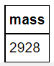
Average Payload Mass by F9 v1.1
Here you can see average payload mass carried by booster version F9 v1.1

Slide 28
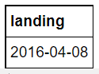
First Successful Ground Landing Date
The date when the first successful landing outcome in ground pad was acheived.

Slide 29
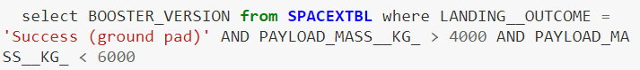
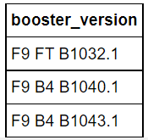
Successful Drone Ship Landing with Payload between 4000 and 6000
The names of boosters which have successfully landed on drone ship and had payload mass greater than 4000 but less than 6000

Slide 30
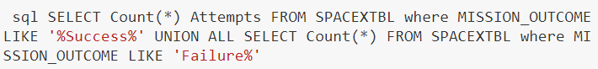
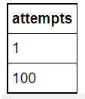
Total Number of Successful and Failure Mission Outcomes
Calculate the total number of successful and failure mission outcomes

Slide 31
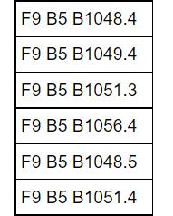
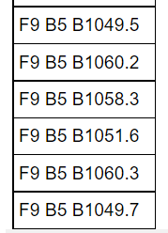
Boosters Carried Maximum Payload
List the names of the booster_versions which have carried the maximum payload mass

Slide 32
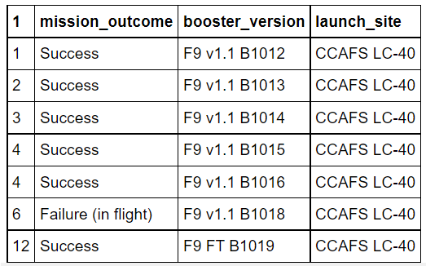
2015 Launch Records
List the failed landing_outcomes in drone ship, their booster versions, and launch site names for in year 2015

Slide 33
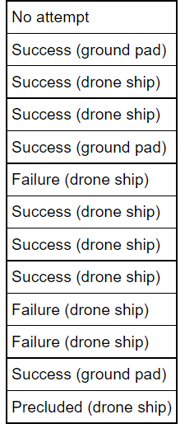
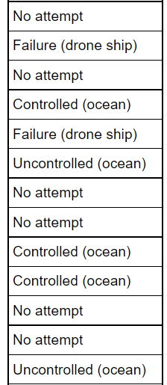
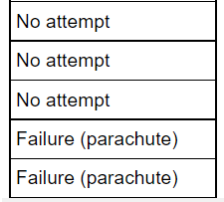
Rank Landing Outcomes Between 2010-06-04 and 2017-03-20
Rank the count of landing outcomes (such as Failure (drone ship) or Success (ground pad)) between the date 2010-06-04 and 2017-03-20, in descending order

Slide 34


Slide 35
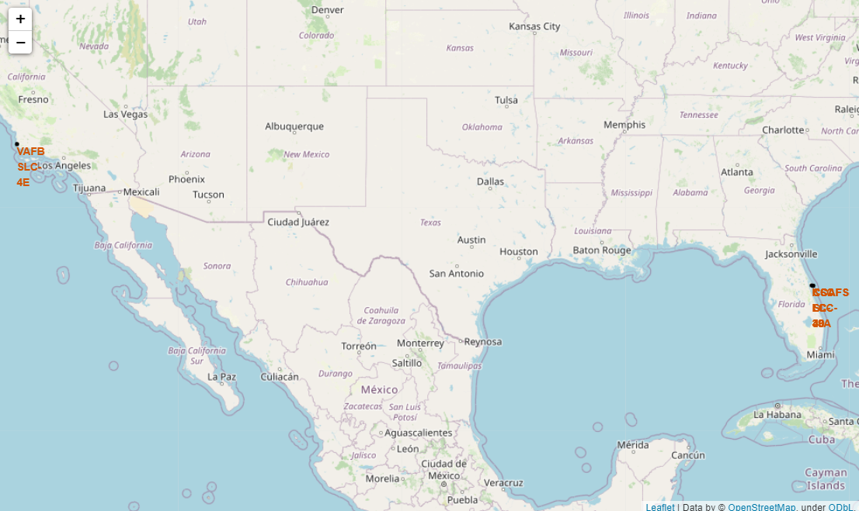
All launch sites
Here we can see that the SpaceX launch sites are in the USA coasts

Slide 36
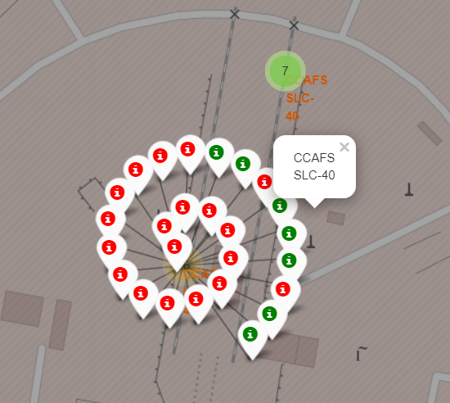
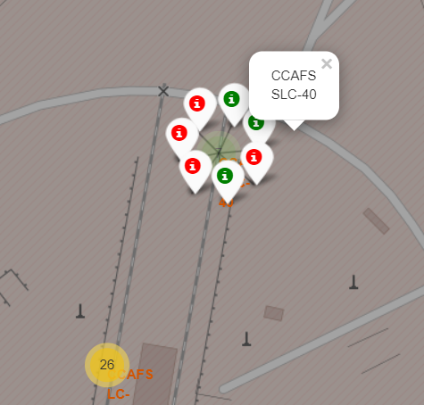
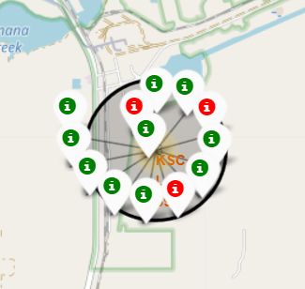
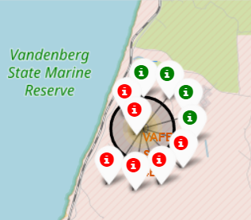
Colour Labelled Markers
Green Marker shows successful Launches and Red Marker shows Failures

Slide 37
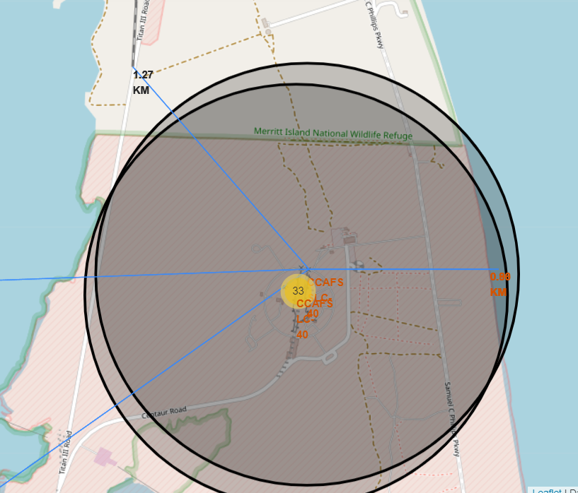
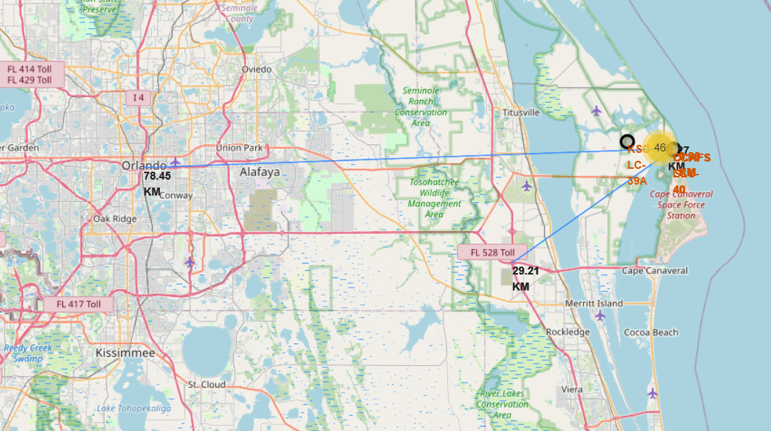
Launch Sites distance
Find trends with Haversine formula using CCAFS-SLC-40 as a reference . 78,5 rm to City, 29 km to highway, 1 km to railway

Slide 38


Slide 39
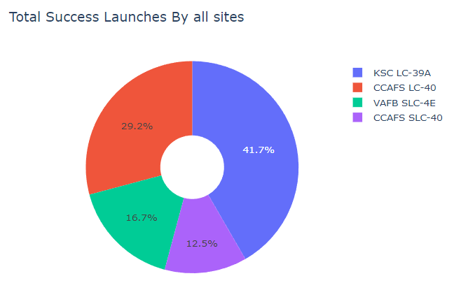
Success launches by all sites
KSC LC-39A had the most successful launches

Slide 40
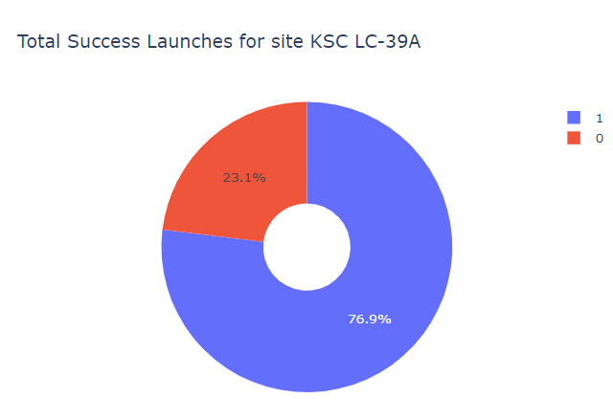
Launch site with highest launch success ratio
KSC LC-39A achieved a 76.9% success rate while getting a 23.1% failure rate

Slide 41
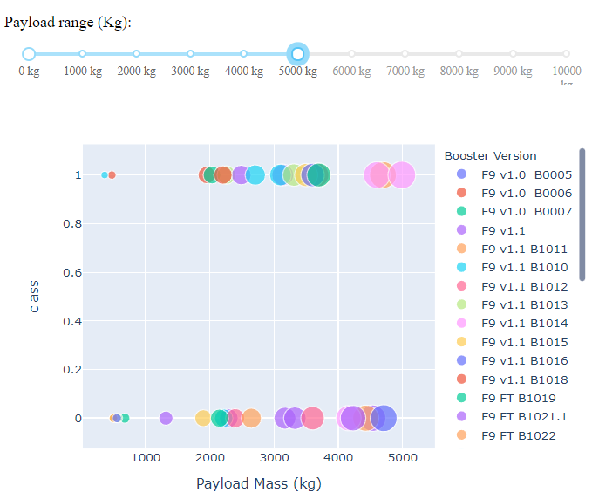
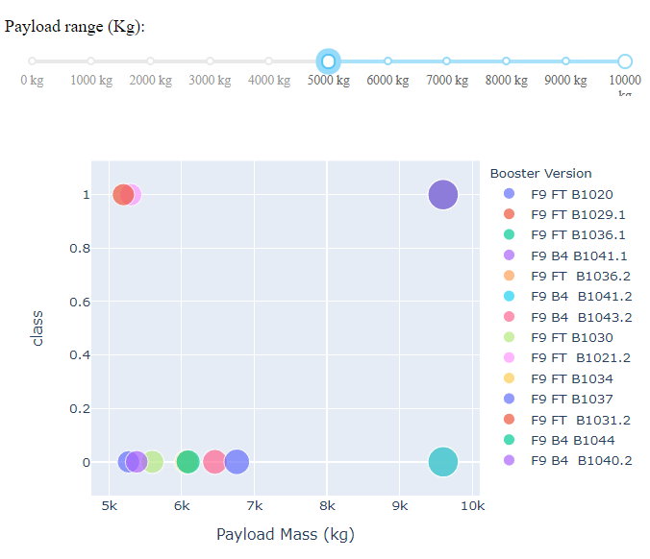
Payload vs. Launch Outcome
the success rates for low weighted payloads is higher than the heavy weighted payloads

Slide 42


Slide 43
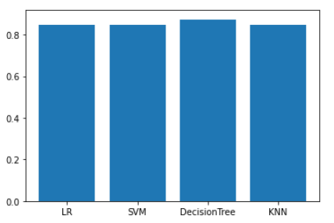
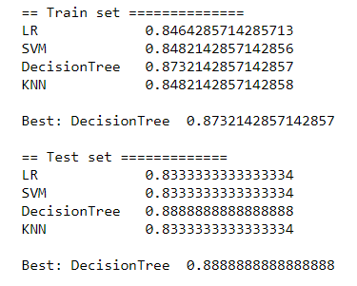
Classification Accuracy
The best model is decision tree with tuned hyperparameters :
criterion: entropy, max_depth: 2, max_features: sqrt, min_samples_leaf: 4, min_samples_split: 10, splitter: best
Accuracy : 0.8732142857142857

Slide 44
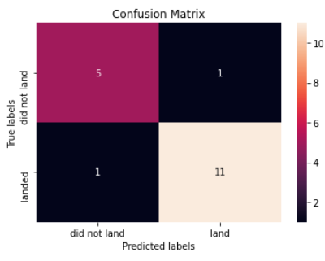
Confusion Matrix
The confusion matrix is an indicator of classification success. We see that our model is quite accurate.

Slide 45
Conclusions
KSC LC-39A had the most successful launch
Orbit GEO,HEO,SSO,ES-L1 has the best result
Low weighted payloads perform better than the heavier payloads
The decision tree classifier is the best in our case (Accuracy : 0.88)

Slide 46
Appendix
SpaceX API Documentation https://docs.spacexdata.com/
Haversine formula https://en.wikipedia.org/wiki/Haversine_formula
DASH https://dash.plotly.com/
Github Repository https://github.com/koav/IBM-DataScience-SpaceX-Project

Slide 47


